Slide 1

LEO Applications
Wireless Reading Group
Reporter: Yi Xu
Date: Dec. 21

Slide 2
Outline
Basics
Orbits
Bent pipe model
Handover
Applications
Earth observation
Traditional handover strategy
RL handover strategy
CDN replica

Slide 3
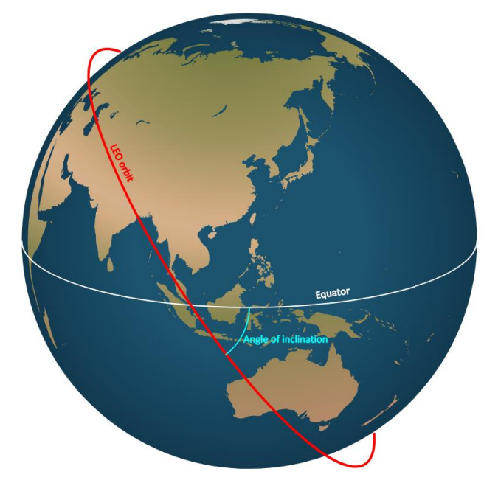
Basics - orbits
An object orbits if it’s falling back down to Earth but is too fast so keeps missing.
Orbital plane
Orbital height
LEO: typically < 2000 km, 2.5ms
Starlink: around 500 km
MEO: around 8000 km, 70ms
GEO: 35,786 km (most conventional comm sats), 0.12s
Inclination, and the longitude of the intersection determines an orbital plane
Notes:
圆形或椭圆形的轨道构成一个轨道平面，这个平面经过地心。
轨道高度是指轨道超出地面的高度，决定了卫星的周期有多快：the lower the quicker.
LEO: Low Earth Orbit;
MEO: Medium Earth Orbit;
GEO: Geostationary Earth Orbit 地球同步轨道卫星.
轨道在地球上的投影和赤道形成的角度叫做卫星的倾角；
轨道的倾角以及轨道和赤道交点的经度共同确定一个轨道平面

Slide 4
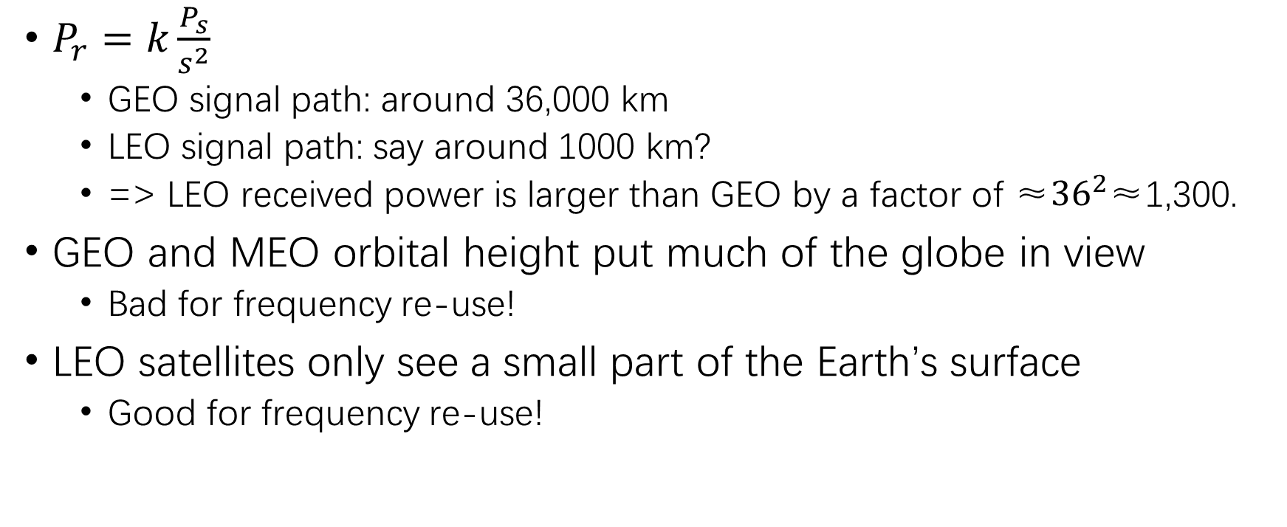
Good news!
$P_{r}=k\frac{P_{s}}{s^{2}}$
GEO signal path: around 36,000 km
LEO signal path: say around 1000 km?
=> LEO received power is larger than GEO by a factor of ≈${36}^{2}$≈1,300.
GEO and MEO orbital height put much of the globe in view
Bad for frequency re-use!
LEO satellites only see a small part of the Earth’s surface
Good for frequency re-use!
Notes:
在其他条件相同的情况下，接收信号的功率和信道距离的平方成反比，所以和LEO通信的信号会更强

Slide 5
The downside of LEO orbits
A LEO sat rises, passes over a ground station and sets on the horizon within minutes
Usually, won’t return for many hours to same location
Need many satellites for 24/7 coverage
MEO: overhead for hours
GEO: always there

Slide 6
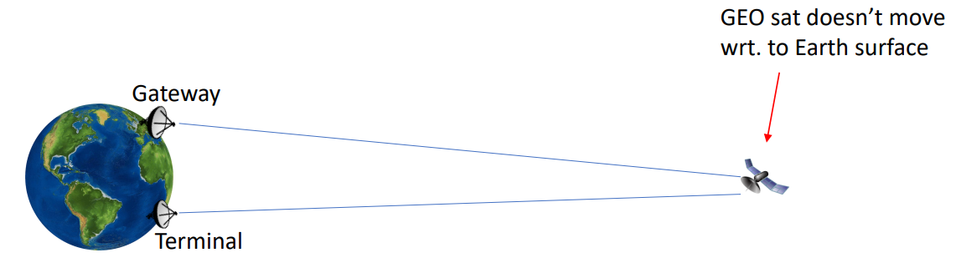

Forwarding and routing
Bent pipe model: Internet $↔$ gateway $↔$ satellite $↔$ terminal
Standard for GEO and MEO

Slide 7
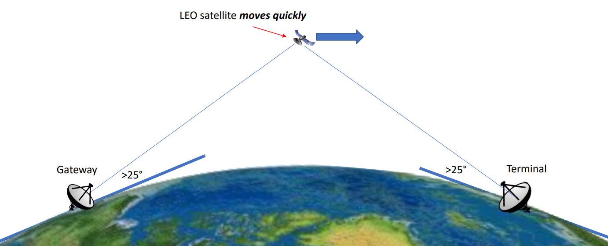
Bent pipe in LEO

Slide 8
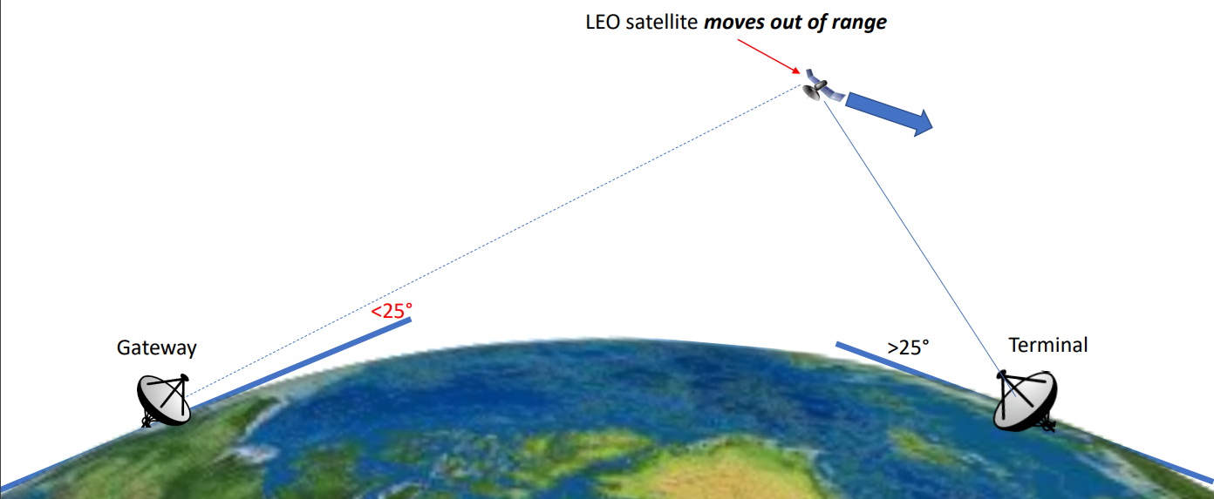
Bent pipe in LEO

Slide 9
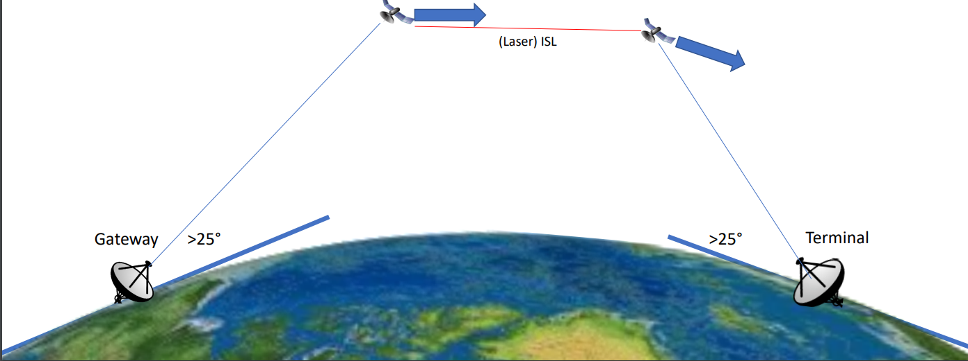
Beyond bent pipe: inter-satellite links (ISLs)
Handover!

Slide 10
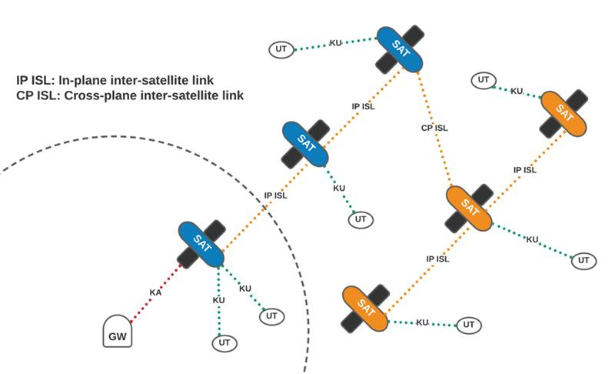
ISLs
Notes:
Each satellite features 3 optical heads, using infrared lasers to communicate with other satellites in the same plane, and across planes.

Slide 11
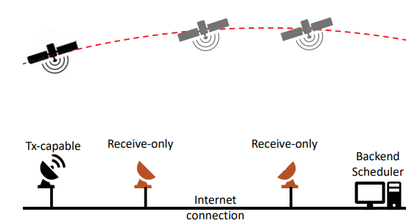
Application 1 – Earth observation
45% agriculture, geological systems, natural disasters, etc.
Specialized (multi-million US dollars) ground stations
Not scalable
High cost
Not robust
Geographically distributed, low cost
Most receive-only
L2D2 structure
L2D2: Low Latency Distributed Downlink for Low Earth Orbit Satellites
Notes:
传统方法：satellite companies购买一些昂贵的、高downlink的服务器，集中从卫星上下载数据。
缺点：not scalable，expensive，单点失效（数量少）。
2021 SIGCOMM
本文提出：地理上分布式的ground station，在楼顶或者后院里就能安置。
主要是从卫星上下载数据，很少用到uplink；ground station today support downlink一般Gbps，uplink几百Kbps。
No ACK: bitmap broadcast to Tx, then to sat (minutes~hours)

Slide 12
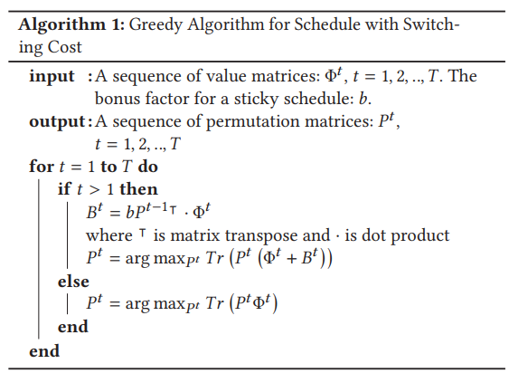
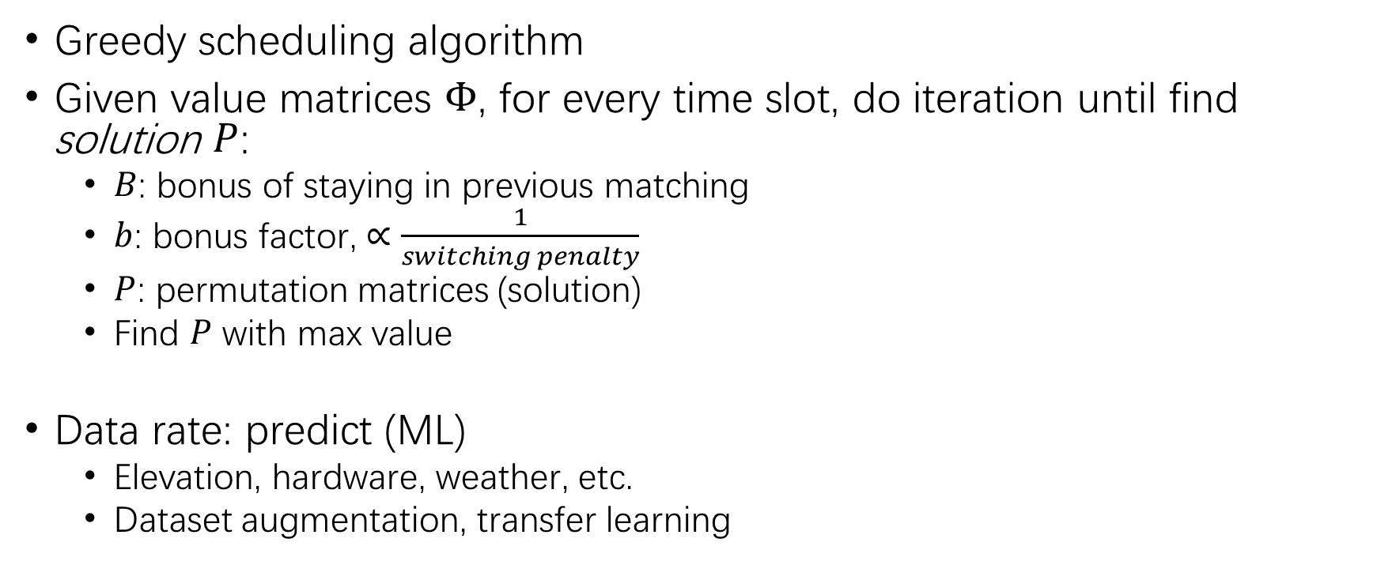
Application 1 – Earth observation
Greedy scheduling algorithm
Given value matrices $Φ$, for every time slot, do iteration until find solution $P$:
$B$: bonus of staying in previous matching
$b$: bonus factor, $∝$ $\frac{1}{switching penalty}$
$P$: permutation matrices (solution)
Find 𝑃 with max value
Data rate: predict (ML)
Elevation, hardware, weather, etc.
Dataset augmentation, transfer learning
L2D2: Low Latency Distributed Downlink for Low Earth Orbit Satellites
Notes:
Scheduling
问题要求的解：哪个卫星被哪个ground station服务
要考虑怎样分配能获得最大价值，所以有价值函数\Phi；
B: 还要考虑switch penalty：卫星从一个ground station换到另一个ground station的switch delay，bonus factor与之成反比
还要考虑data rate，如果太低，没有充分利用downlink的带宽；太高，会造成丢包 ->feedback? Predict √
Receive-only, no ACK to sat in trans layer/app layer
影响因素：卫星离地面的高度可以通过轨道信息计算出来；硬件影响可以提前度量；天气带来的loss也有模型可以预测
在实际测量中，卫星和ground station周围的环境也会对传输质量有影响（比如卫星上的太阳能板，速度的稳定性，建筑物，树）
最终用ML，用部署几天的数据train
有些卫星对天气更敏感，所以在数据集里对这部分卫星加入云层遮挡和对应的预测的SNR数据；在部署新的ground station的时候，会把训练好的网络的大部分layer都冻结，只留最后一层，还有线性回归的部分，加入新的ground station产生的数据进行train。这样就能保留网络中train好的关于卫星的信息。

Slide 13
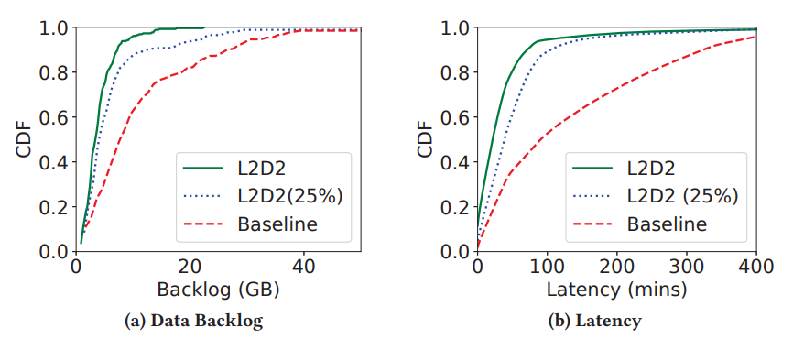
Application 1 – Earth observation
Results
L2D2: Low Latency Distributed Downlink for Low Earth Orbit Satellites
Notes:
CDF: 概率密度函数

Slide 14
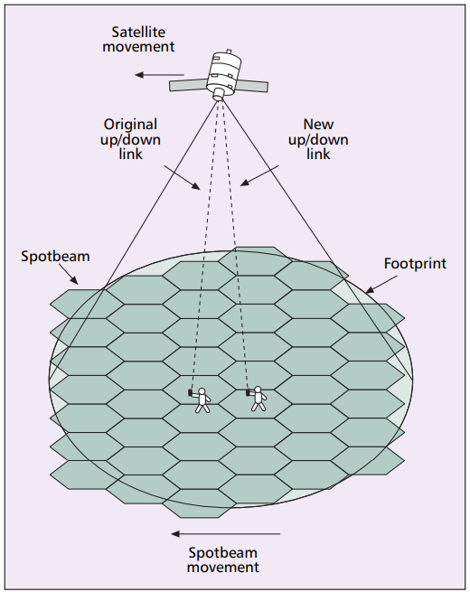
Application 2 – traditional handover
Link-layer handover
Spotbeam handover
Satellite handover
Network-layer handover
HANDOVER SCHEMES IN SATELLITE NETWORKS: STATE-OF-THE-ART AND FUTURE RESEARCH DIRECTIONS
Notes:
Survey

Slide 15
Application 2 – traditional handover
Spotbeam handover
Fixed channel allocation (FCA)
Dynamic channel allocation (DCA)
Guaranteed handover schemes
Guaranteed prioritized handover schemes
HANDOVER SCHEMES IN SATELLITE NETWORKS: STATE-OF-THE-ART AND FUTURE RESEARCH DIRECTIONS
Notes:
Satellite footprint is divided into smaller cells called spotbeam -> better frequency utilization.
Spotbeam handover: 假设用户相对于高速运动的卫星不动。释放当前通信的链路，获得一个邻近spotbeam的链路继续通信 (most common)。
Classified based on channel allocation strategy.
FCA: 每个channel被固定分配到cell。如果在新的cell里，被分配到的channel还有空闲的，那么handover就可以成功，否则通信会被block或者drop。
DCA: channel都被放在一个池子里，需要channel的call就从池子里拿走一个channel；打完电话后，channel被释放，回到池子里。
有的策略保证handover成功，call不要被block掉，总是为next cell 预留channel；有的策略追求性能，尽量让handover成功，但也允许新的call占用channel（FIFO）

Slide 16
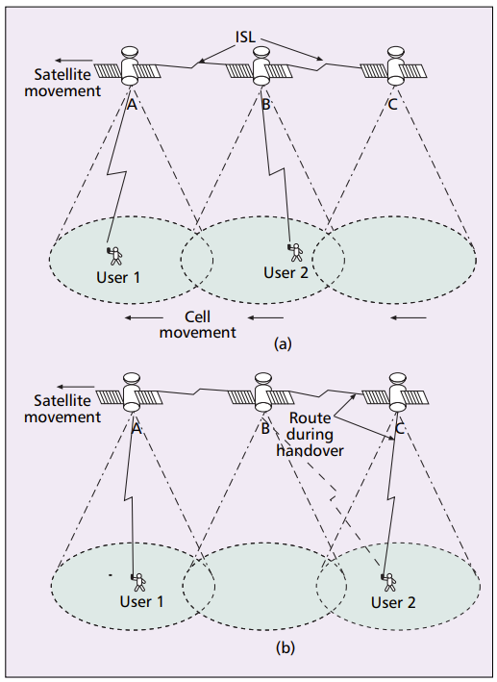
Application 2 – traditional handover
Satellite handover
Hard handover scheme (threshold)
Doppler effect scheme
Selection criteria
Visibility time
Capacity
Elevation angle
Notes:
User 1在和user 2打电话，通过A->B
变成1->A->B->C->2
Spotbeam handover中，用户属于的spotbeam是计算好的；但是satellite handover中，用户可选的卫星有很多个。
Hard handover scheme: naïve的handover是，只要信号衰减到fade margin以下，就换卫星；hard的策略是设一个动态的threshold，当信号衰减到fade margin以下，再把不同卫星的信号强度和threshold比较，尽可能延迟、减少handover。
除了考虑信号衰减带来的handover，还要考虑即将到来的卫星已经没有可分配的channel了。可以通过在两个时间点的多普勒效应，计算卫星的位置，延迟为用户预留channel的时间，这样可以让即将到来的卫星有更多channel可分配

Slide 17
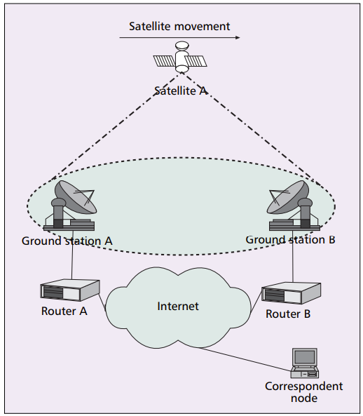
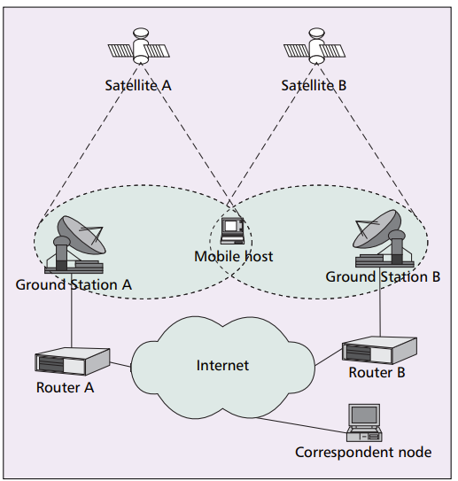
Application 2 – traditional handover
Network handover
Reason: IP address changes
Decision phase
Network controlled
Mobile controlled
Network assisted
Mobile assisted
Satellite as router
Satellite as mobile host
HANDOVER SCHEMES IN SATELLITE NETWORKS: STATE-OF-THE-ART AND FUTURE RESEARCH DIRECTIONS
Notes:
Reason: communication endpoints change IP address (sat as router: footprint/spotbeam changes; sat as mobile host: also change IP)
对于decision phase，handover可以分为以下几类：
NC：network monitors the link quality and decides whether to initiate handover;
MC：mobile host monitors and decides;
NA：network sends info to MH, MH decides;
MA：类似的.

Slide 18
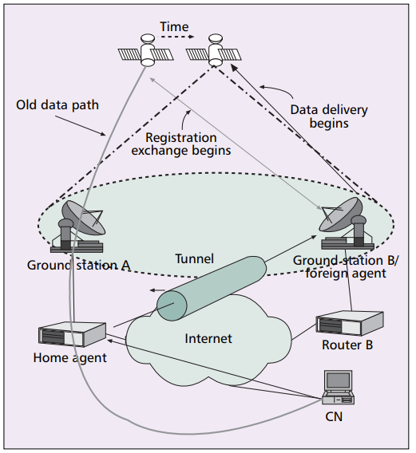
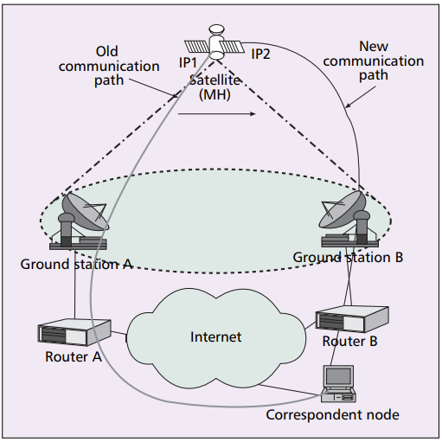
Application 2 – traditional handover
Network handover
Execution phase
Hard schemes
Soft schemes
Signaling diversity schemes
Mobile IP handover
Signaling diversity
HANDOVER SCHEMES IN SATELLITE NETWORKS: STATE-OF-THE-ART AND FUTURE RESEARCH DIRECTIONS
Notes:
对于execution phase，handover可以分为以下几类：
Hard: current link is released before new link is established (NASA: mobile IP, home agent and foreign agent, keep upper-layer connections alive)先中断和原来的连接，再register，建立新的连接；会有large handover latency and high packet loss rate.
Soft: 先建立新连接，再中断旧连接.
Signaling diversity: signaling procedures performed through both old and new, while data through old link.先和B建立连接，获得IP2，进行signaling，同时用IP1继续data transfer。一旦A drop signaling，就丢弃IP1，用IP2 data transfer -> smooth

Slide 19
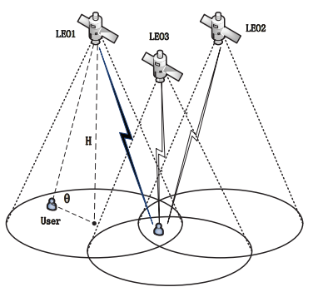
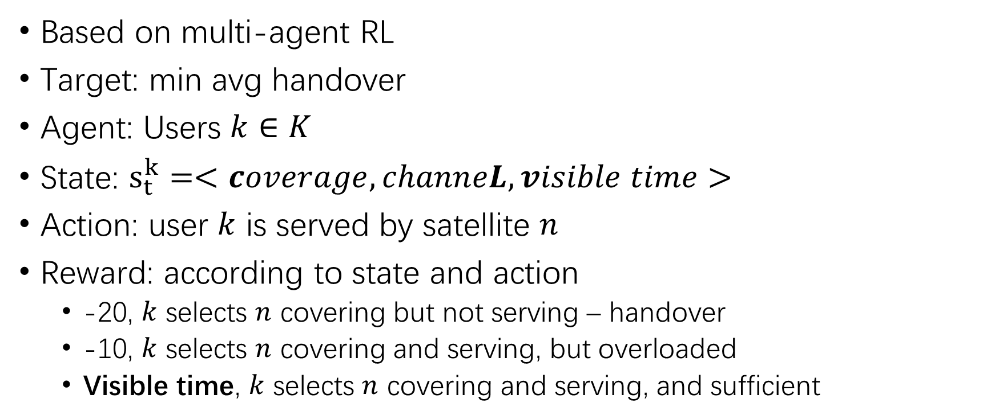
Application 3 – RL handover strategy
Based on multi-agent RL
Target: min avg handover
Agent: Users $k∈K$
State: $s_{t}^{k}=<coverage, channeL, visible time>$
Action: user $k$ is served by satellite $n$
Reward: according to state and action
-20, $k$ selects $n$ covering but not serving – handover
-10, $k$ selects $n$ covering and serving, but overloaded
Visible time, $k$ selects $n$ covering and serving, and sufficient
action
state
agent
env
reward
Load-Aware Satellite Handover Strategy Based on Multi-Agent Reinforcement Learning
Notes:
t时刻的状态：卫星信号对用户的覆盖情况（有一个最小的高度角），卫星可划分的信道数，卫星可以继续服务用户的时间

Slide 20
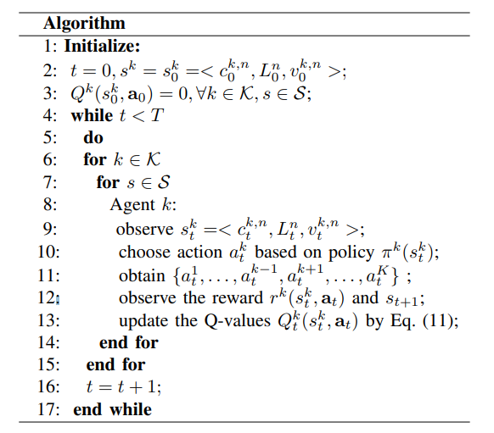
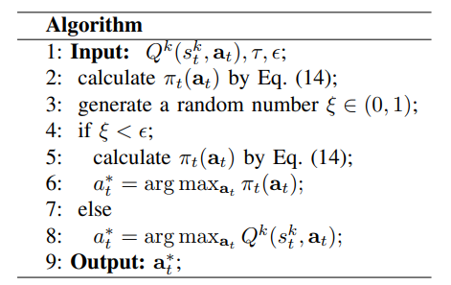
Application 3 – RL handover strategy
action
state
agent
env
reward
Exploitation and exploration
Q-learning
Load-Aware Satellite Handover Strategy Based on Multi-Agent Reinforcement Learning
Notes:
\epsilon: exploration parameter \in [0,1)
\xi: random parameter
Exploitation: agents choose the best action based on current Q-values;
Exploration: agents try more actions that are not exploited so far.

Slide 21
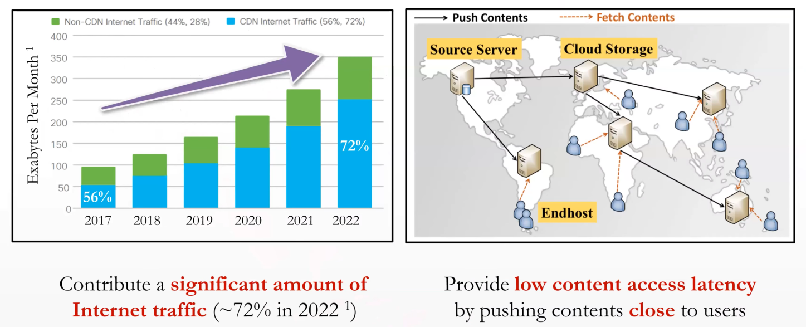
Application 4 – CDN replica
CDN – Content Distributed Network

Slide 22

Application 4 – CDN replica
Problem setup
Open cost of satellite = transfer cost (handover) + storage cost
Connection cost of clients
Total cost = $\sum_{t}{(open cost+connection cost)}$
Target
Min total cost

Slide 23
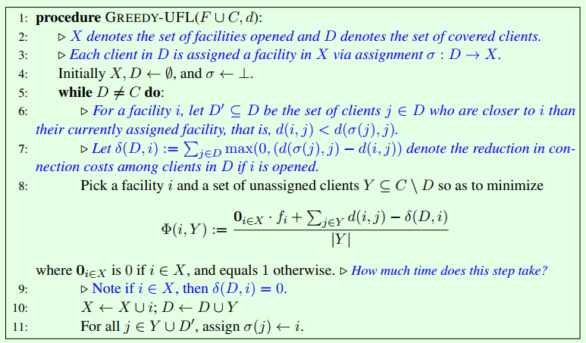
Application 4 – CDN replica
Original greedy
Exponential!
Methods:
Sort
Dual problem
Greedy Facility Location Algorithms Analyzed using Dual Fitting with Factor-Revealing LP

Slide 24
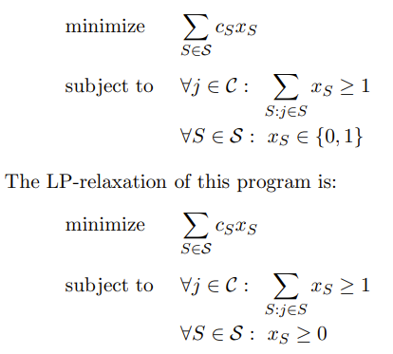
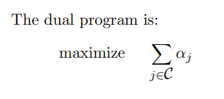

Application 4 – CDN replica
Advanced greedy by primal-dual method
Primal problem
Dual problem
Regard $α_{j}$ as the money which client $j$ will pay for satellite
Greedy Facility Location Algorithms Analyzed using Dual Fitting with Factor-Revealing LP

Slide 25
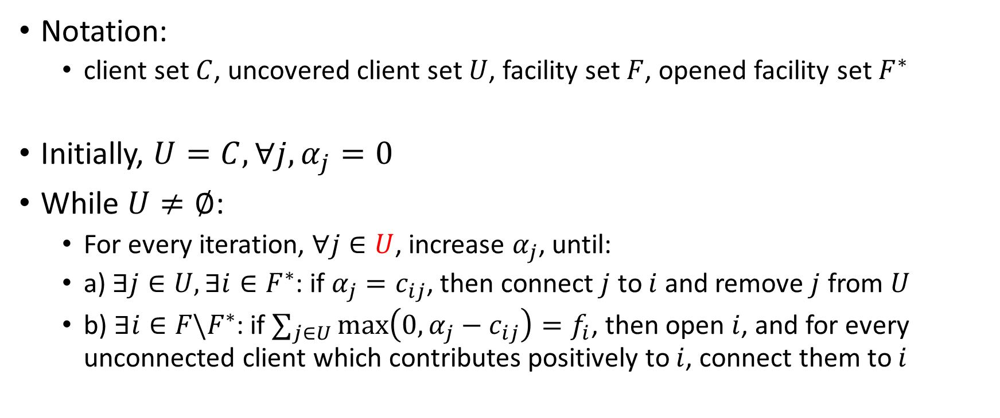
Application 4 – CDN replica
Notation:
client set $C$, uncovered client set $U$, facility set $F$, opened facility set $F^{∗}$
Initially, $U=C, ∀j, α_{j}=0$
While $U≠∅$:
For every iteration, $∀j∈U$, increase $α_{j}$, until:
a) $∃j∈U,∃i∈F^{∗}$: if $α_{j}=c_{ij}$, then connect $j$ to $i$ and remove $j$ from $U$
b) $∃i∈F\backslash F^{∗}$: if $∑_{j∈U}\max\left(0,α_{j}−c_{ij}\right)=f_{i}$, then open $i$, and for every unconnected client which contributes positively to $i$, connect them to $i$
Greedy Facility Location Algorithms Analyzed using Dual Fitting with Factor-Revealing LP

Slide 26
Application 4 – CDN replica
Advanced greedy by primal-dual method
Target is to cover all the clients
Increase money of clients
If money is sufficient to connect to an opened replica, then connect
If money is sufficient to open a new replica, then open
2
3
1
1
1
2
2
3
Greedy Facility Location Algorithms Analyzed using Dual Fitting with Factor-Revealing LP

Slide 27
Application 4 – CDN replica
Advanced greedy by primal-dual method
Target is to cover all the clients
Increase money of clients
If money is sufficient to connect to an opened replica, then connect
If money is sufficient to open a new replica, then open
Iteration step=1, all the uncovered clients have money of 1
2
3
1
1
1
2
2
3
Greedy Facility Location Algorithms Analyzed using Dual Fitting with Factor-Revealing LP

Slide 28
Application 4 – CDN replica
Advanced greedy by primal-dual method
Target is to cover all the clients
Increase money of clients
If money is sufficient to connect to an opened replica, then connect
If money is sufficient to open a new replica, then open
Iteration step=3, all the uncovered clients have money of 3
2
3
1
1
1
2
2
3
has contribution from clients: (3-2)*2+(3-1)*2=6 > open cost, say 5

Slide 29
Application 4 – CDN replica
Advanced greedy by primal-dual method
Target is to cover all the clients
Increase money of clients
If money is sufficient to connect to an opened replica, then connect
If money is sufficient to open a new replica, then open
Iteration step=3, all the uncovered clients have money of 3
2
3
1
1
1
2
2
3
has contribution from clients: (3-2)*2+(3-1)*2=6 > open cost, say 5 $→$

Slide 30
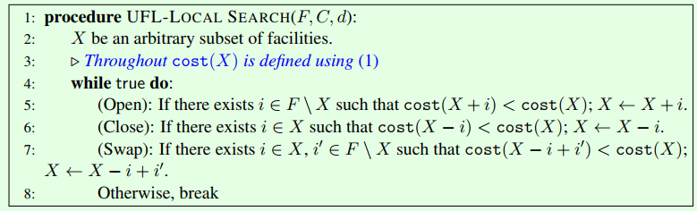
Application 4 – CDN replica
Local search
What’s more? DP
Local Search Algorithms for Facility Location

Slide 31
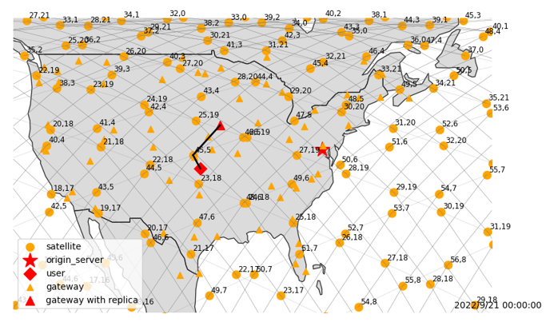
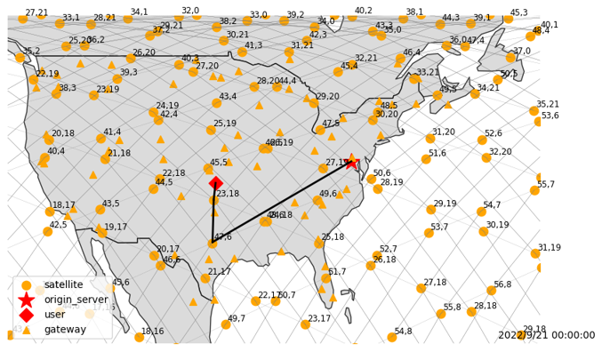
Application 4 – CDN replica
Advantage of DP method
Take slightly higher cost for present, but benefit the future
DP
No DP

Slide 32
Application 4 – CDN replica
 | Alg | Total cost | Storage cost | Query cost | Trans cost | Time | Opt ratio
mawi | Naïve | 48096 | 0 | 0 | 0 | - | 0
 | Greedy dual 1.61 | 18066 | 1442 | 15174 | 1450 | 44.94s | 62.4%
 | Greedy sort | 20002 | 1313 | 17139 | 1550 | 3s | 58.4%
 | LSDP-hzy | 13927 | 1983 | 9394 | 2550 | 76915.62s | 71%
 | LS-xy-addDel | 22222 | 1310 | 18512 | 2400 | 2s | 53.8%
 | LS-xy-exhuastive | 18906 | 1200 | 16156 | 1550 | 3.17s | 60.7%
wiki | Naïve | 46999 | 0 | 0 | 0 | - | 0
 | Greedy dual 1.61 | 30543 | 1608 | 28235 | 700 | 132.23s | 35%
 | Greedy sort | 31116 | 6299 | 18717 | 6100 | - | 33.8%
 | LSDP-hzy | 25112 | 3668 | 19794 | 1650 | 3986.57s | 46.6%
 | LS-xy-addDel | 33589 | 1225 | 30964 | 1400 | 8.3s | 28.5%
 | LS-xy-exhuastive | 32343 | 1300 | 30143 | 900 | 11.58s | 31.2%
Notes:
Implementation result

Slide 33
Thank you!

